Slide 1
Presentation for Competition
Autonomous System B
Group A
Younsuk Choi
Caio Luiz Candeias Flores
Ukamaka Akumili Anaedu
Pritish Sanjay Samant
Younsuk Choi

Slide 2
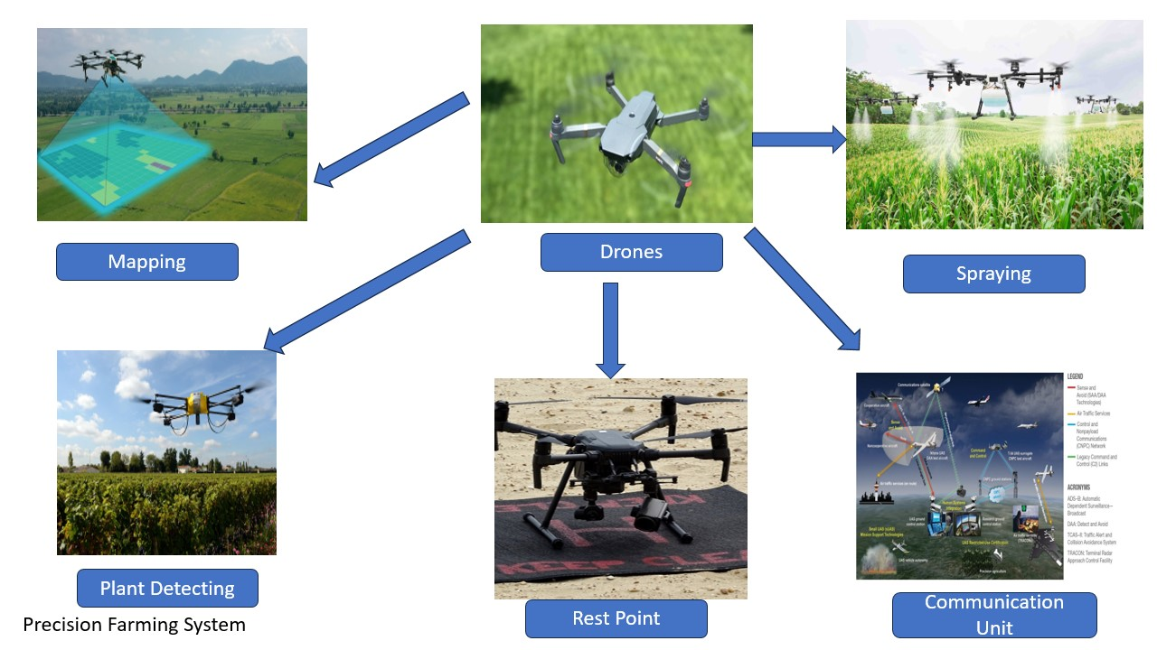
Autonomous Precision Farming System

Slide 3
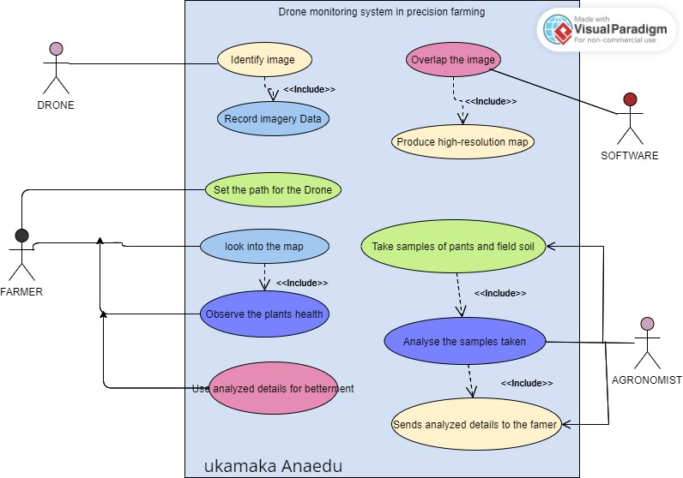
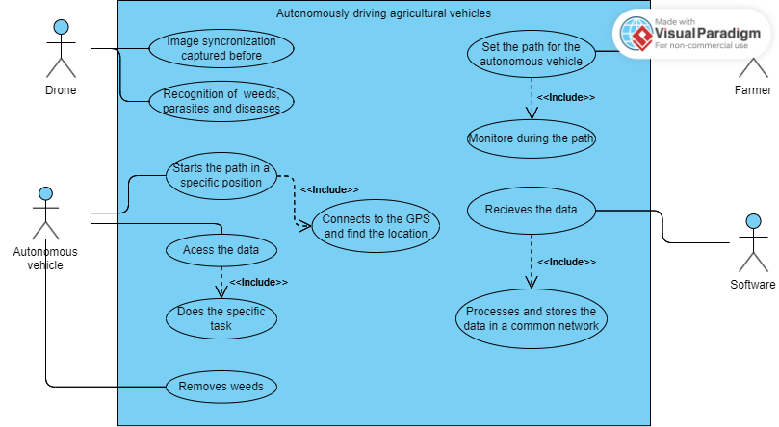
Use Cases

Slide 4
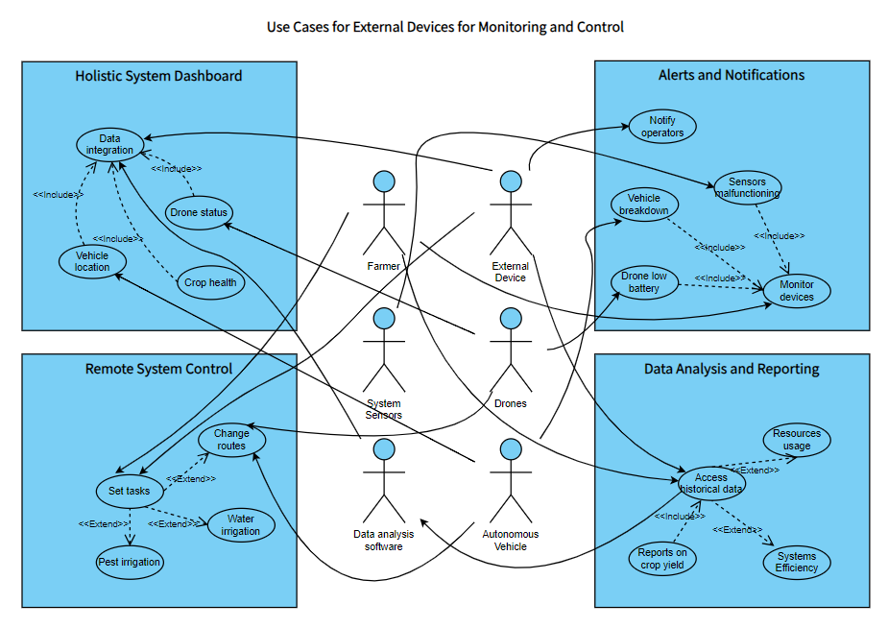
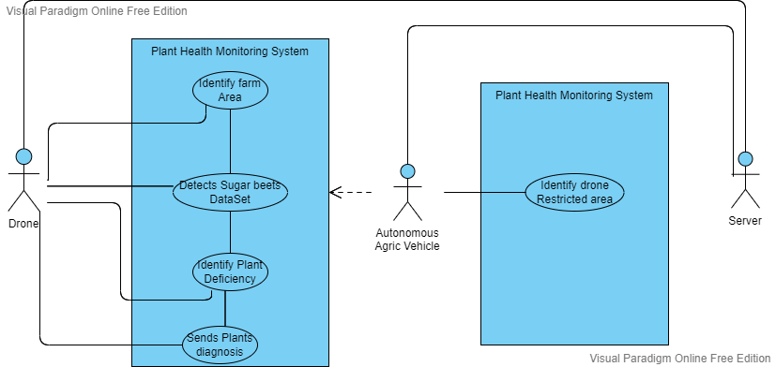

Slide 5
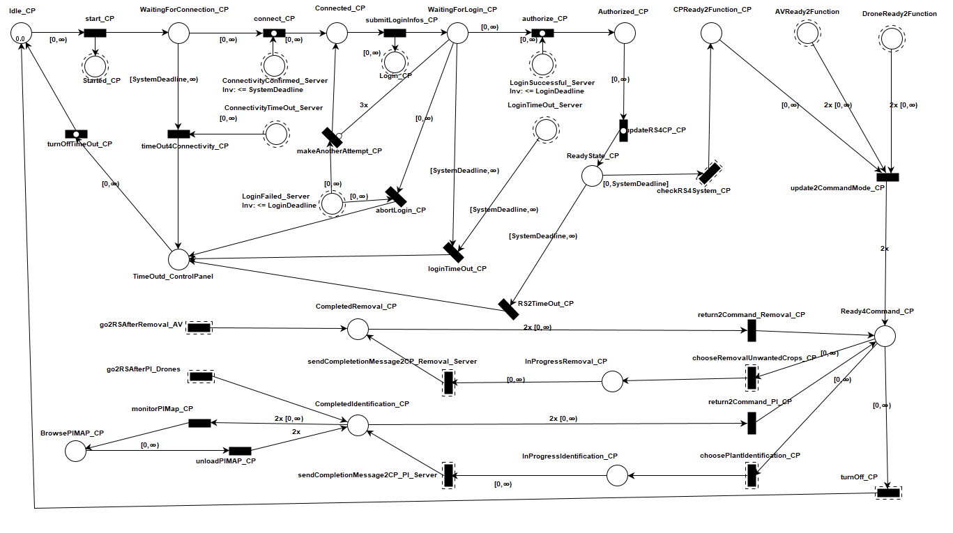
Comprehensive Tapaal Model
Component_Farmer_Control Panel
Younsuk Choi

Slide 6
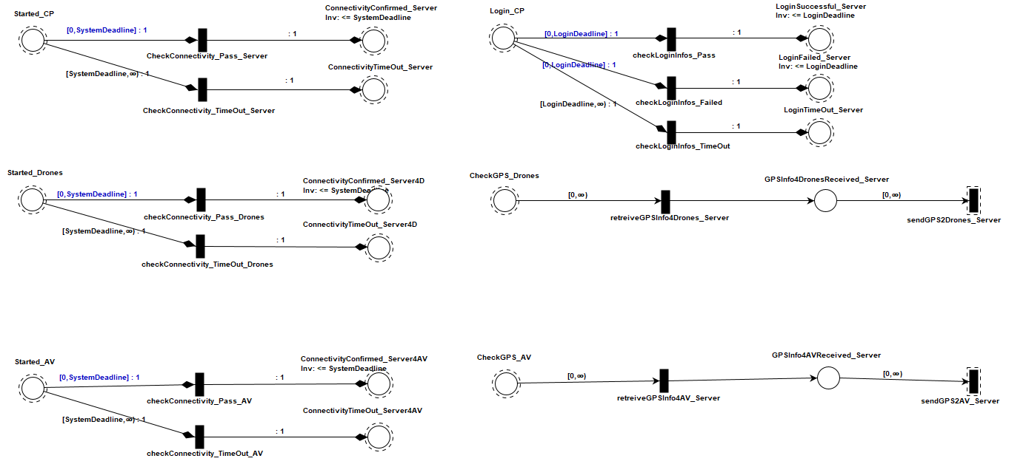
Comprehensive Tapaal Model
Component_Initialization Server
Younsuk Choi

Slide 7
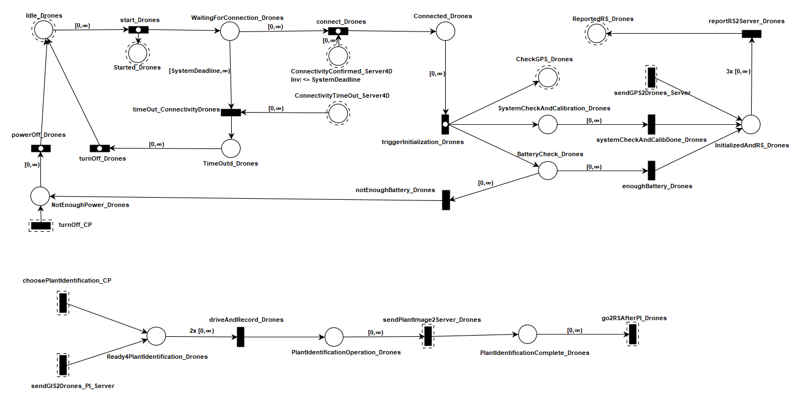
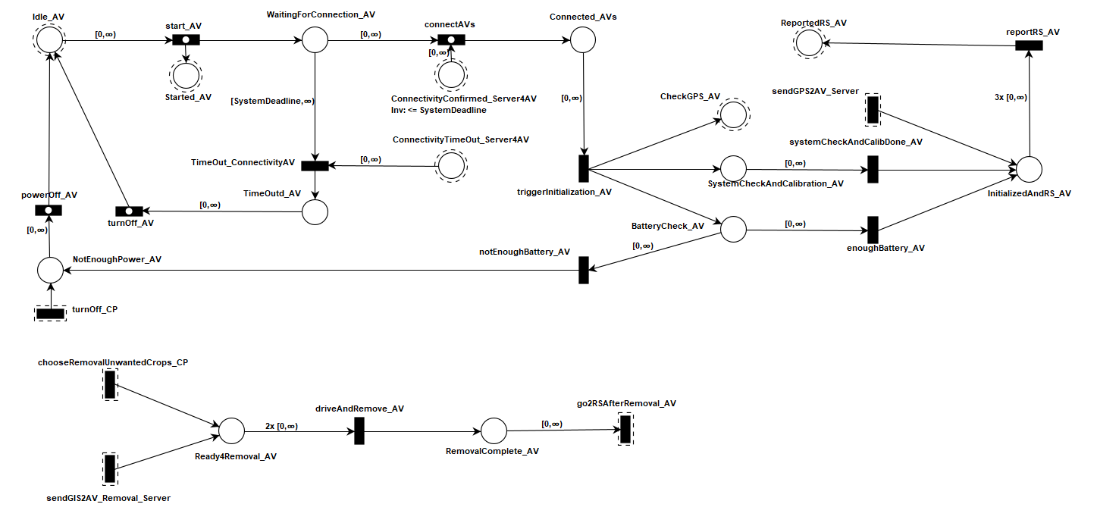
Comprehensive Tapaal Model
Component_Autonomous Vehicles
Component_Drones
Younsuk Choi

Slide 8
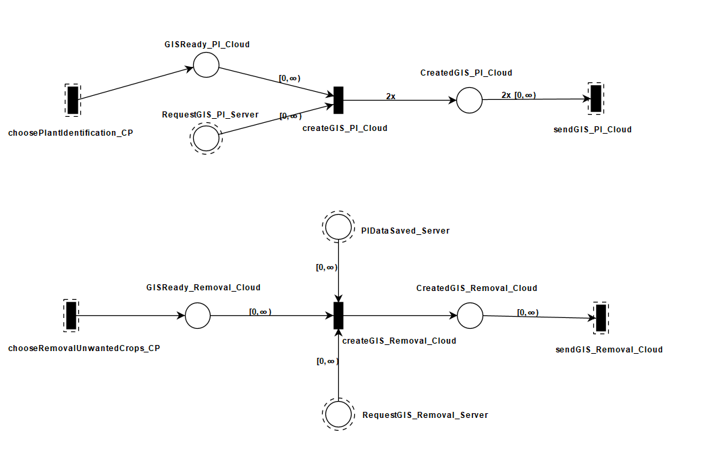
Comprehensive Tapaal Model
Component_Cloud
Younsuk Choi

Slide 9
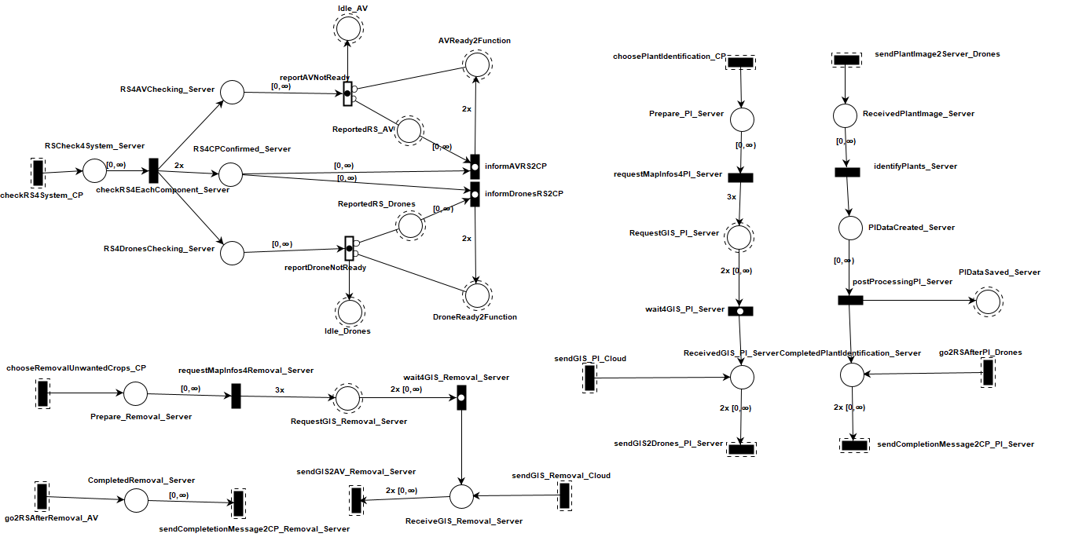
Comprehensive Tapaal Model
Component_Function_Server
Younsuk Choi

Slide 10
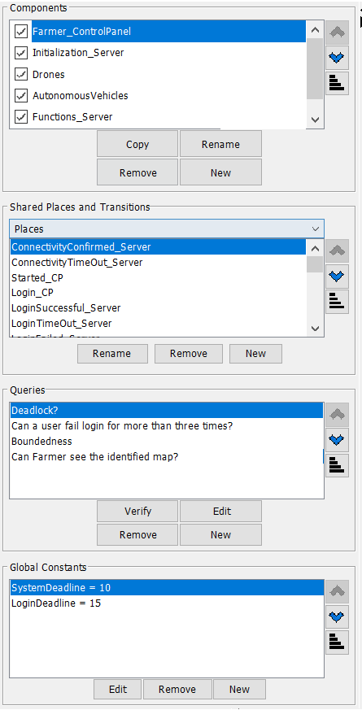
Comprehensive Tapaal Model
Deadlock?
Boundness of a place
Boundness of the system
Liveliness and Reachability
WorkSpace View
Younsuk Choi

Slide 11
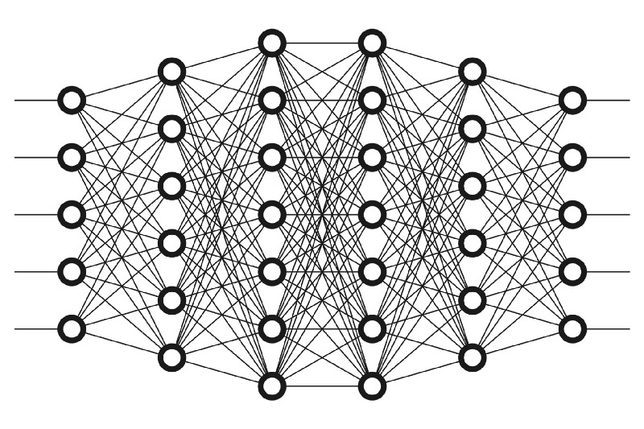
Deep Learning & CNN
Deep learning uses Artificial network to predict or classify different types of data.
It consists of different types of layers; input layer, hidden layers and output layer.
A convolutional neural network (CNN) is a type of artificial neural network used primarily for image recognition and processing, due to its ability to recognize patterns in images.
Types of CNN architectures – Lenet, VGGNet, ResNet, MobileNets, ZFNet, AlexNet, etc.
Pritish Sanjay Samant

Slide 12
Lenet Model
LeNet was developed in 1998 by Yann LeCun, Corinna Cortes, and Christopher Burges.
Lenet – First CNN architecture.
Lenet is an algorithm or architecture based on Convolutional Neural Network.
Three convolutional layers, two pooling layers, one fully connected layer, and one output layer make up the seven layers of the convolutional neural network Lenet.
Pritish Sanjay Samant

Slide 13
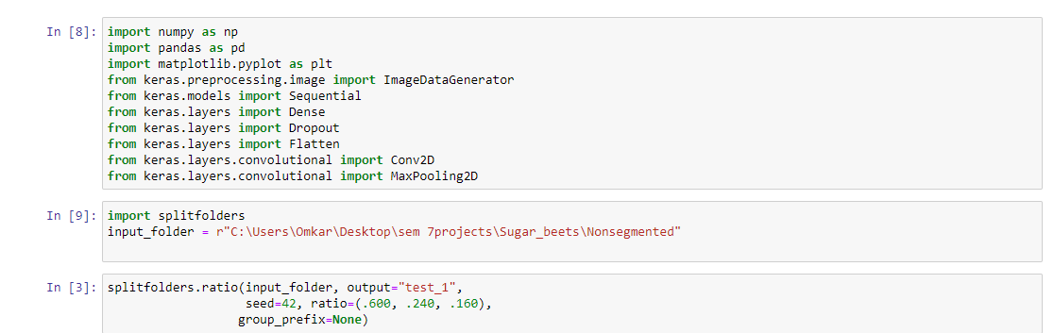
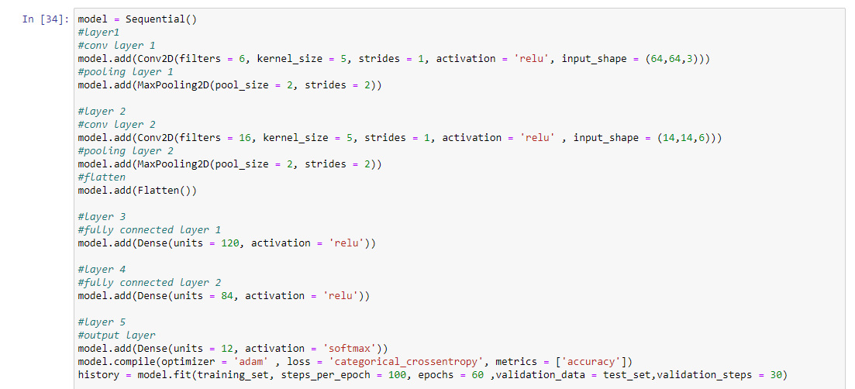
Lenet Model
Pritish Sanjay Samant

Slide 14
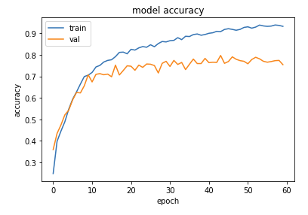
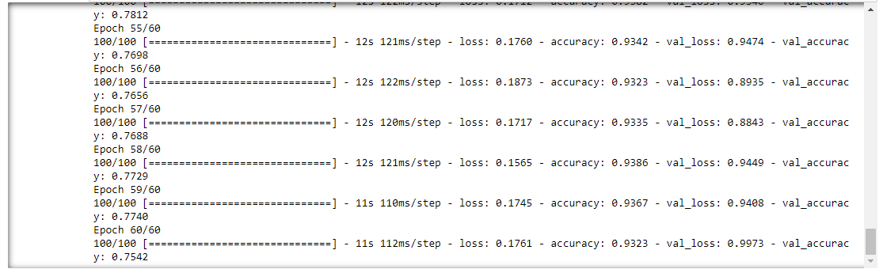
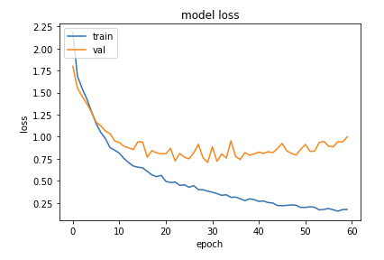
Lenet Model
Pritish Sanjay Samant

Slide 15
Topics to talk about for each model
Algorithms used for each model (ResNet50, FastAi, Lenet)
Dataset and type of classification
Optimizations (such as learning rate or additional layers)
Evaluation metrics
Interpretation (curves and/or confusion matrix)
Younsuk Choi

Slide 16
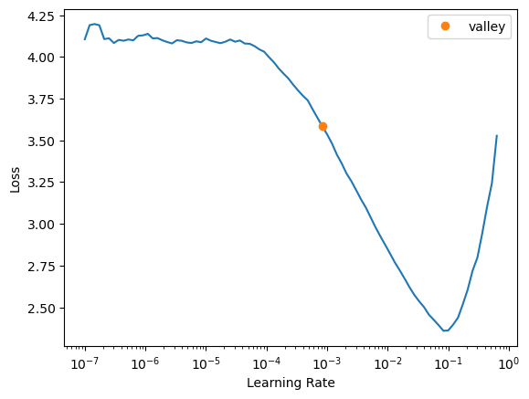
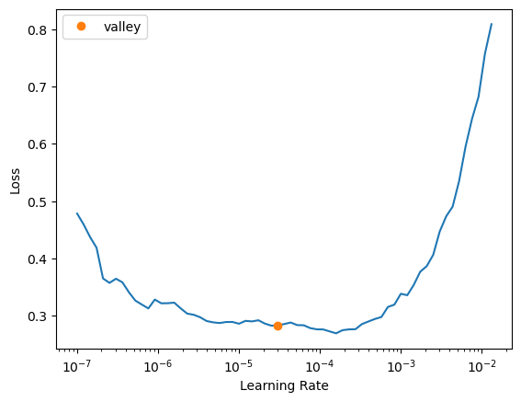
FastAi Model and variants - learning rate and freeze/unfreeze
Caio Luiz Candeias Flores

Slide 17
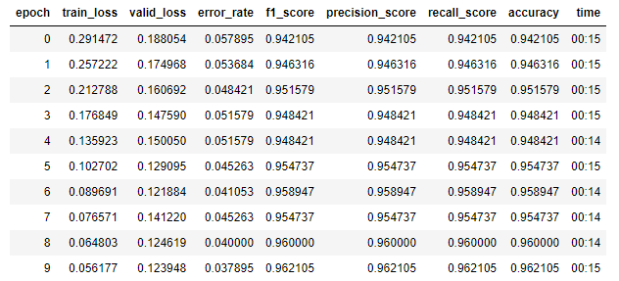
FastAi Model and variants - multiclassification
Caio Luiz Candeias Flores

Slide 18
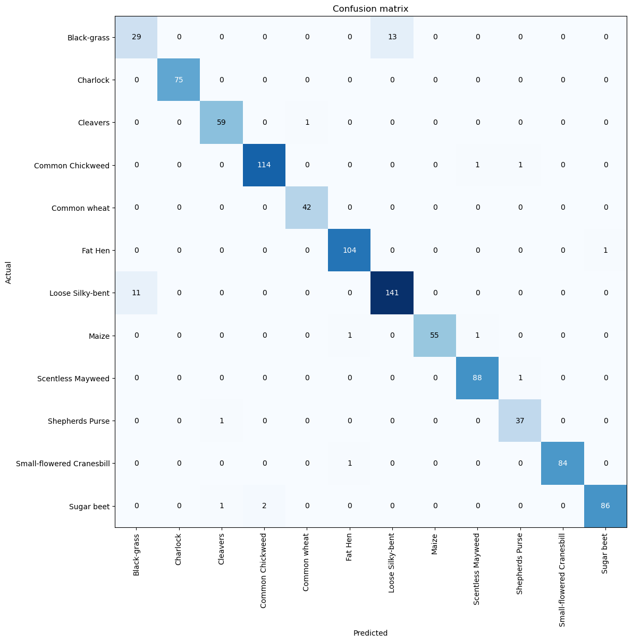
FastAi Model and variants - multiclassification
Caio Luiz Candeias Flores

Slide 19
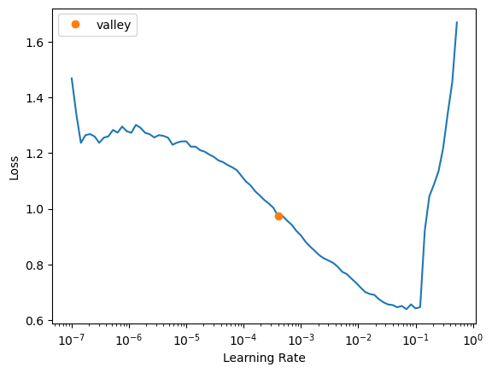
FastAi Model and variants - Binary classification with extracted images from the video
Caio Luiz Candeias Flores

Slide 20
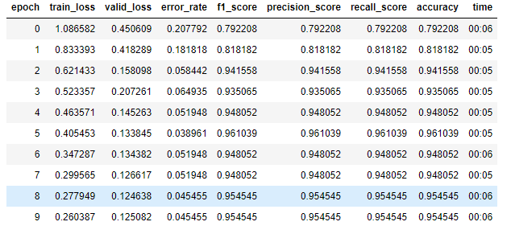
FastAi Model and variants - Binary classification (Weed vs Not Weed)
Caio Luiz Candeias Flores

Slide 21
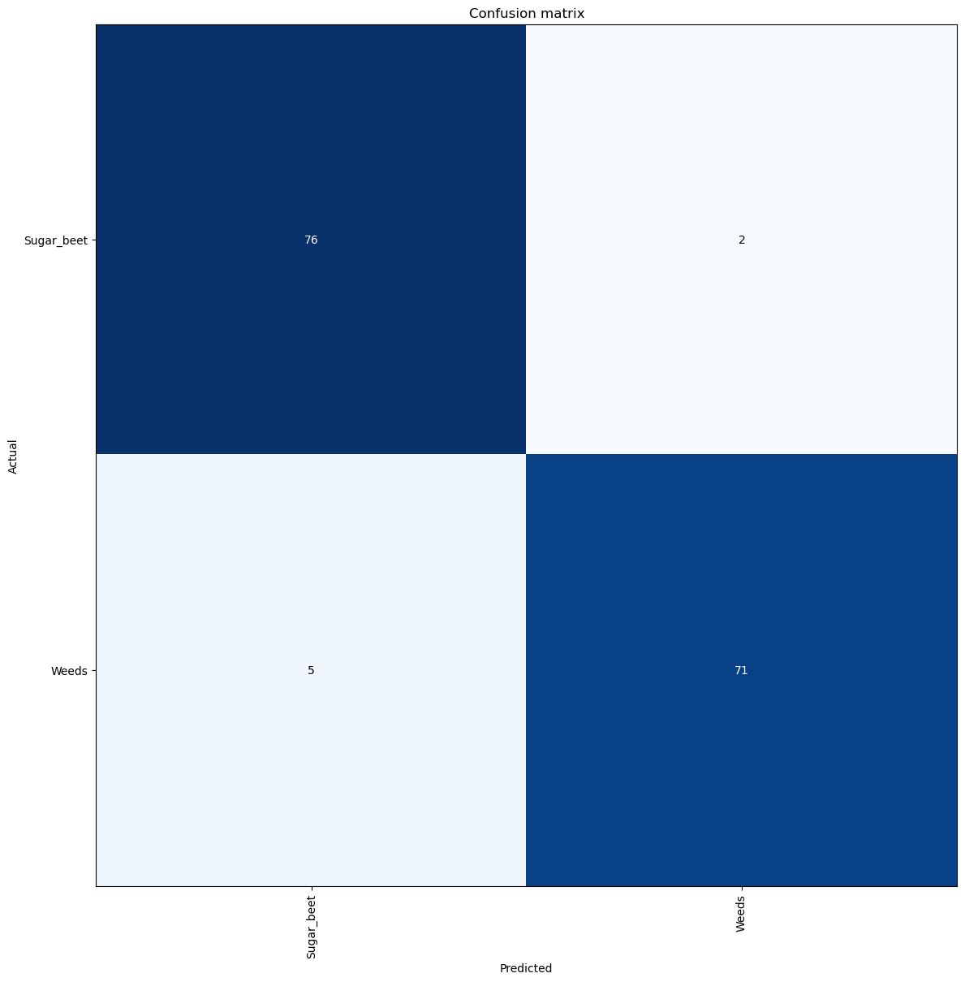
FastAi Model and variants - Binary classification (Weed vs Not Weed)
Caio Luiz Candeias Flores

Slide 22
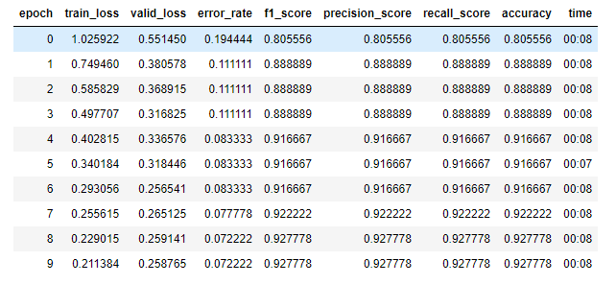
FastAi Model and variants - Binary classification extracted images from the video
Caio Luiz Candeias Flores

Slide 23

FastAi Model and variants - Binary classification extracted images from the video
Caio Luiz Candeias Flores

Slide 24
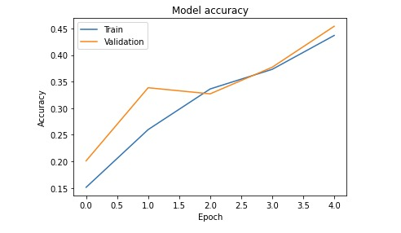
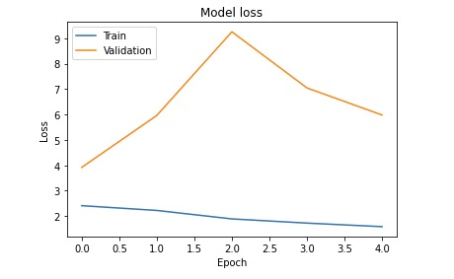
Lenet Model
Pritish Sanjay Samant

